Slide 1

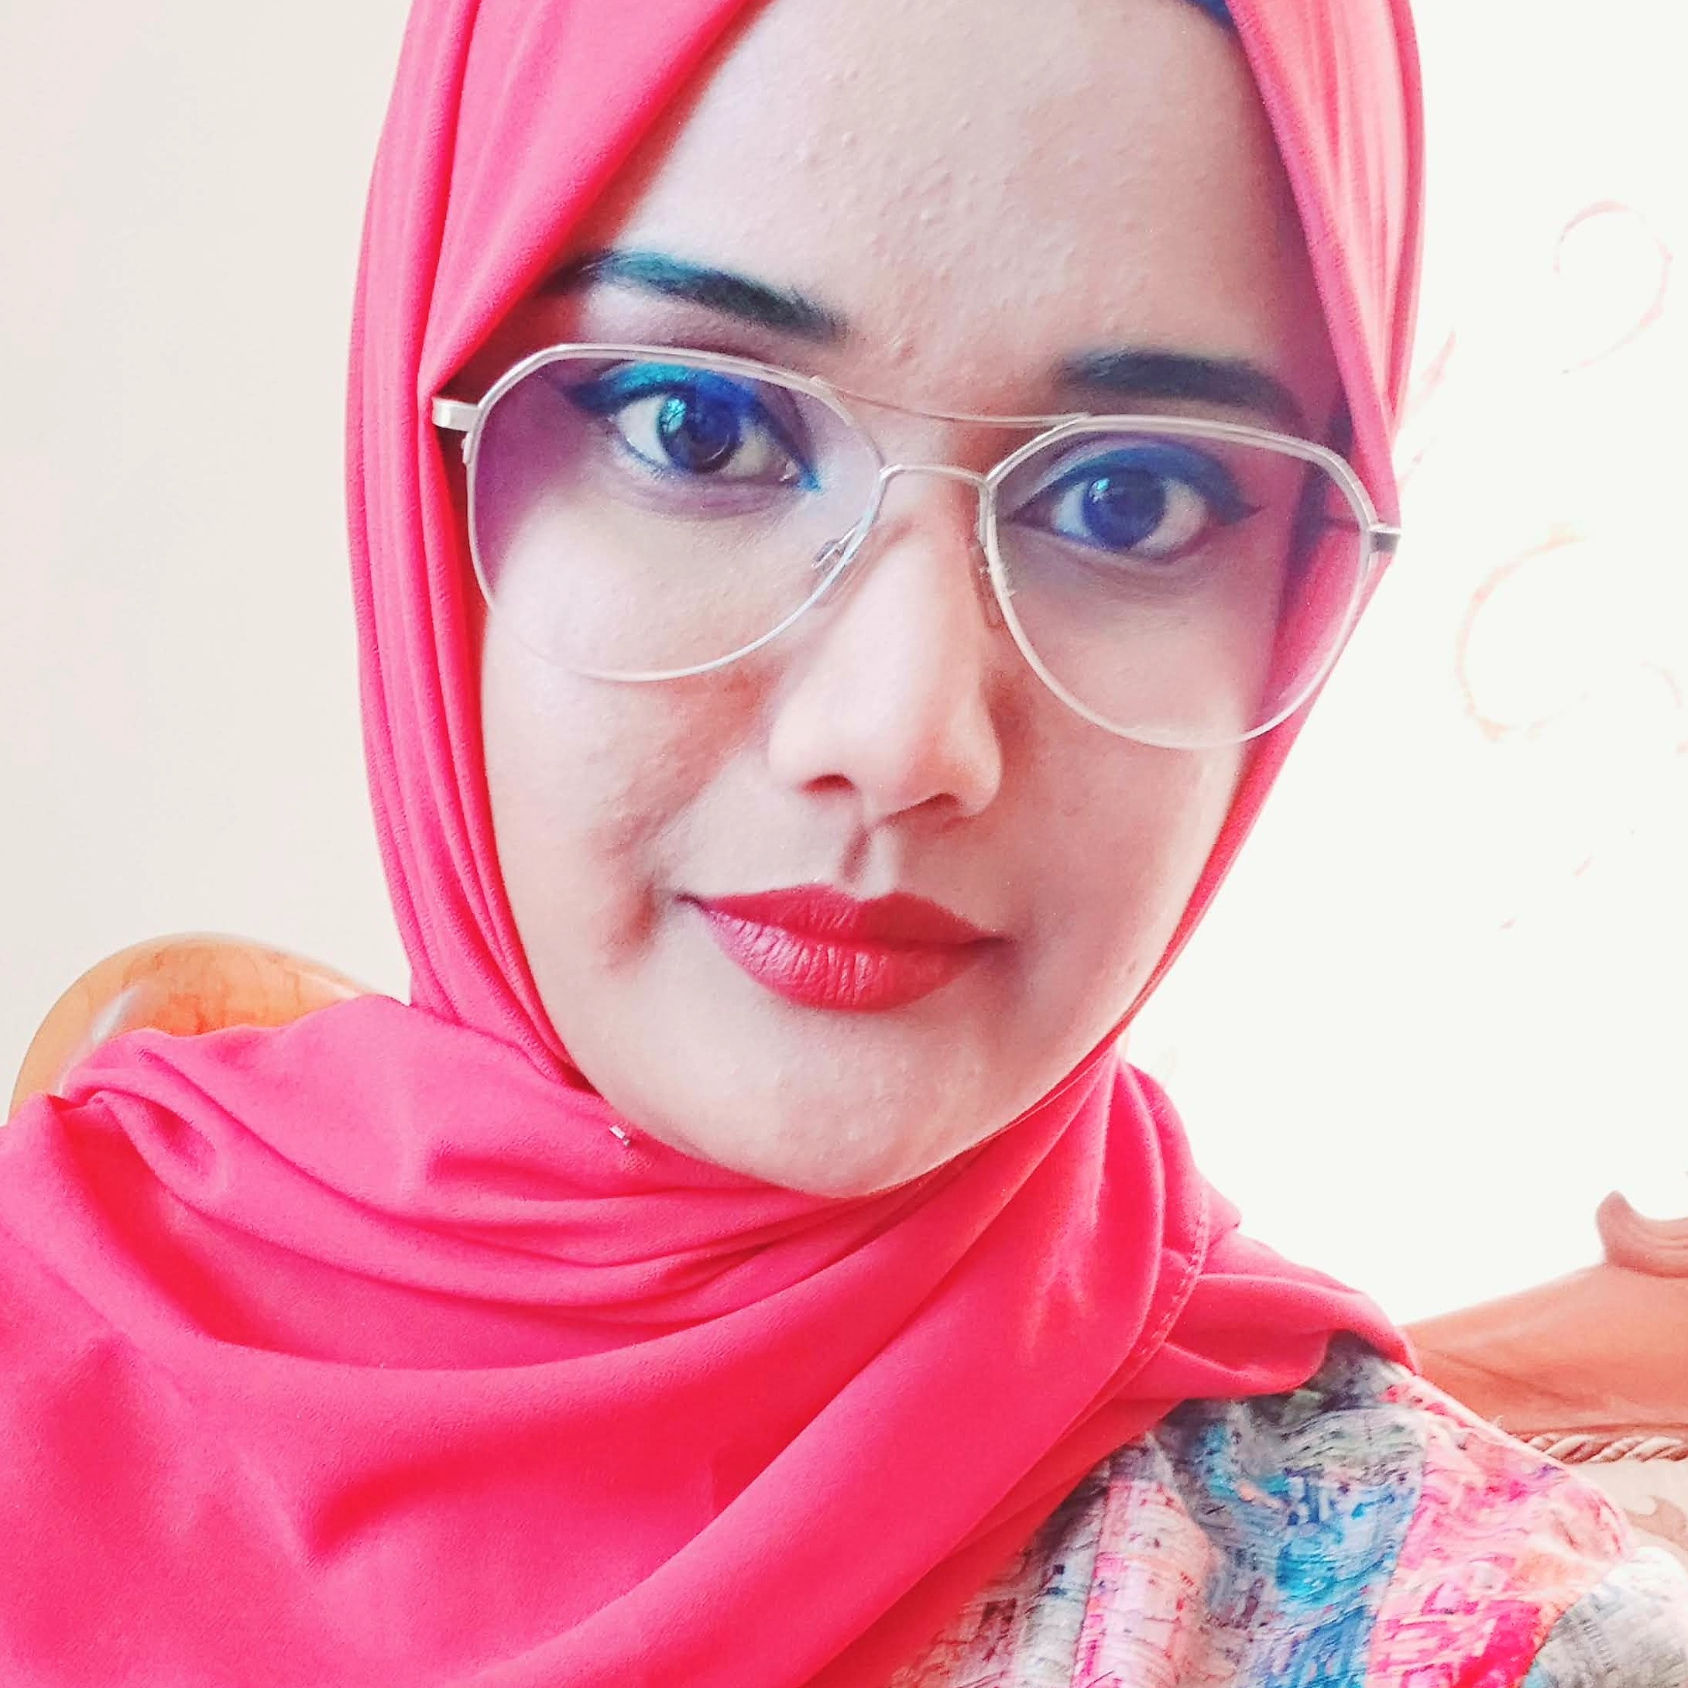

Experience
Areas of expertise
Data Engineer( Apr 2021 - Present)
Internship : Azure Fundamentals, Power BI, Power Apps
Developing a mobile app using Power Apps and Power BI.
Functional
Agile / Design Thinking
UX / UI
Analytical abilities
Automation Testing
Technical
Web (HTML5/CSS3/JS/TS/PHP)
Java
Angular/ React
Spring
AWS
Python
Tosca
GIT
Docker
Azure
SQL(SSMS)
Power BI
Power Apps
Mushirah Bibi MOHIT
Education
Data Engineer
MSc Applied Software Technologies
University of Mauritius, 2020-2021
BSc(Hons) Physics with Computing
University of Mauritius, 2016-2019
Certifications
Microsoft Azure Fundamentals AZ-900
Microsoft Azure Data Fundamentals DP-900
Application Development Associate Ebène, Mauritius.
Professional background
Master of Applied Software Technologies
Internships(Non-Accenture):​
Radiation Protection Authority(Support Technical section)​
FBG SC (Teaching)​
I love solving problems by playing around with new technologies and help achieve better User experience.

Slide 2

Current Experience
Data Engineer Intern
Skills & Technologies
I am responsible for the following project activities:
Designing a mobile application to improve patient care using Power Apps.
Learning about Power Apps, Power BI and Azure Services.
Working with the team to come up with the proper approach to tackle various design and implementation problems.
Skills
Teamwork
Analysis & solutions design
Problem Solving
Creativity
Technical
Azure DevOps
SQL Server Management Studio
Power Apps
Git
Power BI

